Slide 1

Football and COVID: Evaluating the impact of disruptions on public transit accessibility and reliability
Luyu Liu
Department of Geography
The Ohio State University
liu.6544@osu.edu
2022/9/8

Slide 2
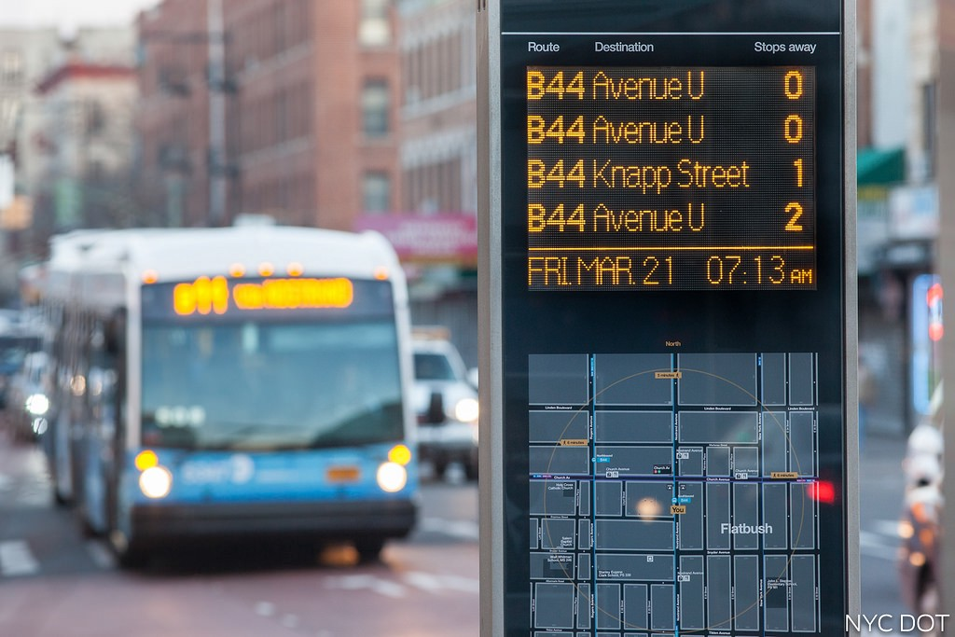
Accessibility, and It Can Be Unreliable
Accessibility is your ability to reach different places
Most accessibility studies use unreliable scheduled data
Expected/scheduled time
Delay: traffic, weather, random disturbances
Real-time data is more reliable
Actual arrival time
High-resolution and high frequency
What users experience
Source

Slide 3
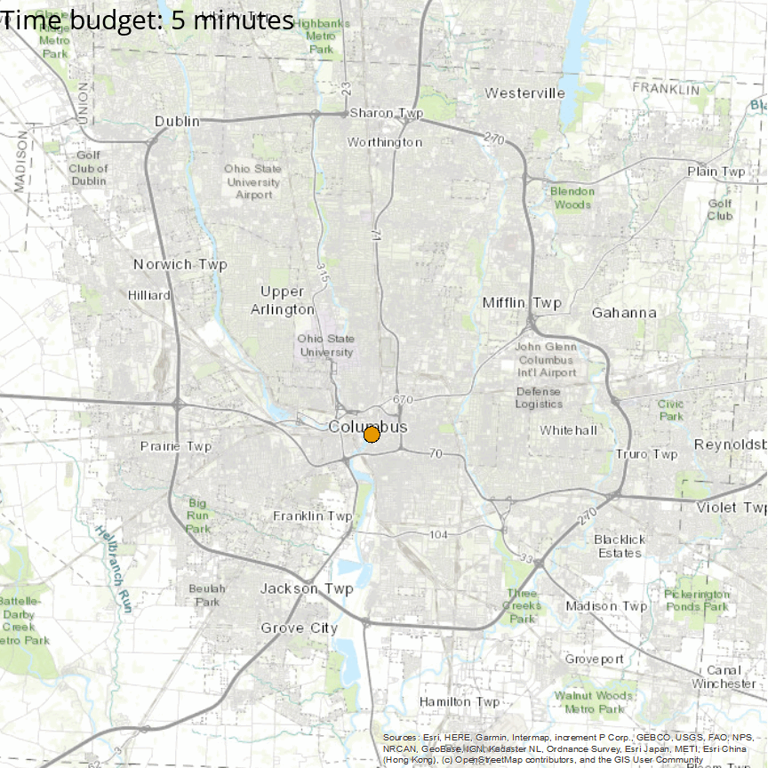
Expectation vs. Reality
How far you can go from Columbus downtown in the real world (orange) versus in the schedule (blue) with different time budgets
Blue: scheduled, expectation from transit authorities and planners
Orange: experienced, reality of passengers
Unreliability: the difference between realizable and scheduled accessibility

Slide 4
Two Disruptions, Six Years of My Life
Short-term disruption: Ohio State Football Game 2018 – 2019
Create massive traffic around Ohio Stadium
Last about few hours
Do not significantly change the schedule
Long-term disruption: The COVID-19 pandemic 2020 – present
Decrease ridership and cut service
Last about few years
Do significantly change the schedule

Slide 5
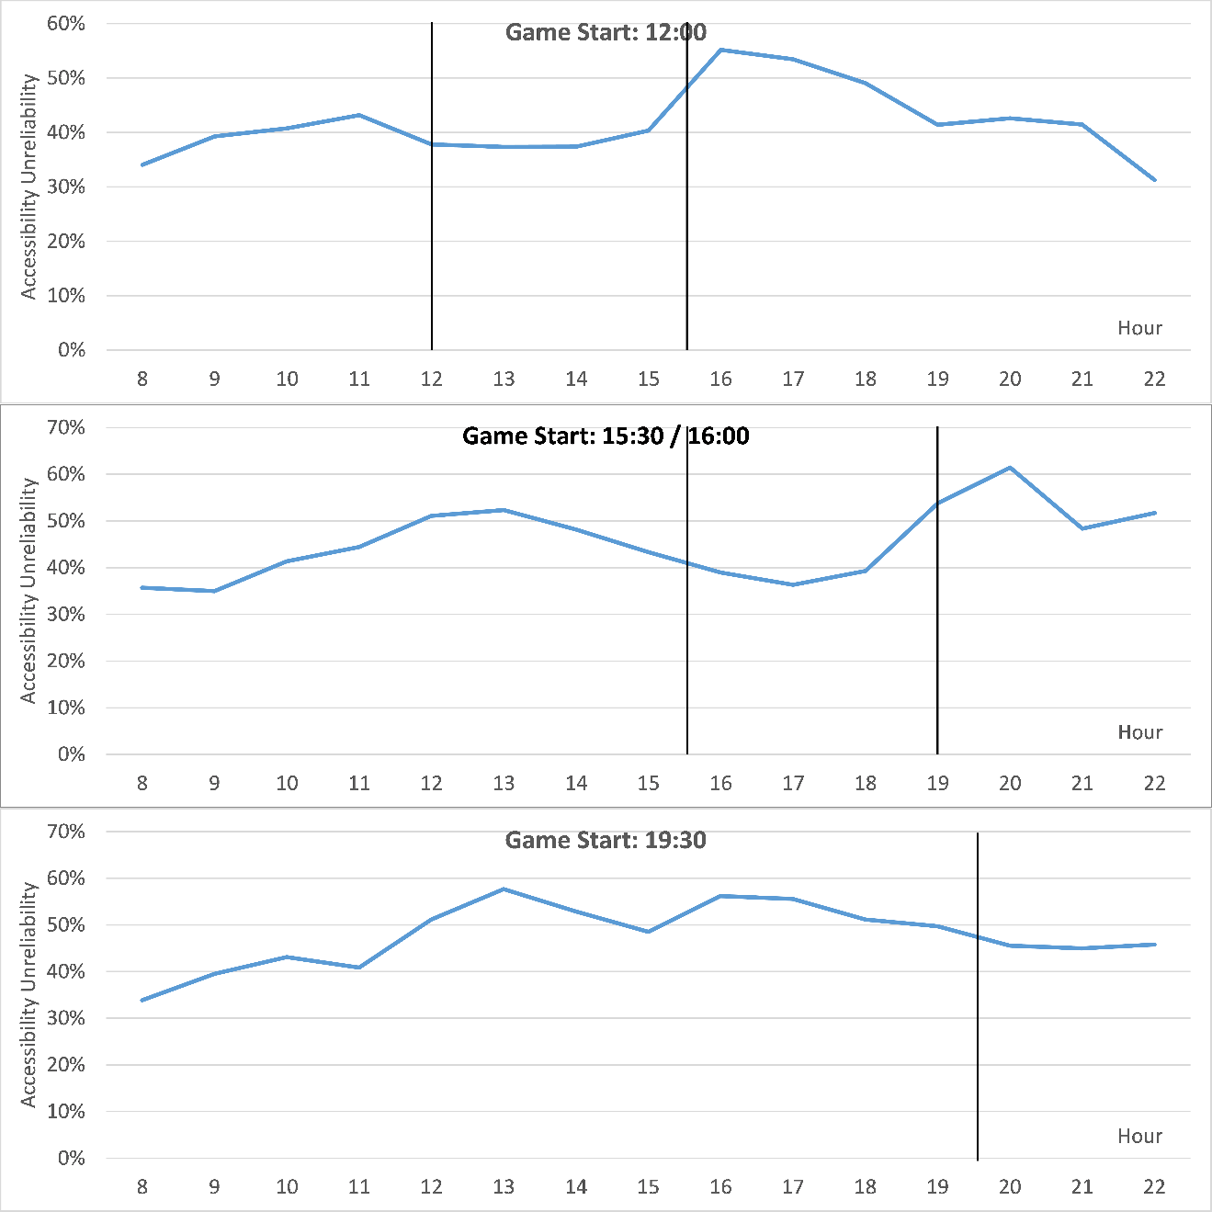
Football: Temporal Pattern
Average hourly profile of unreliability on all 13 OSU football game days
Black lines indicates start and end of each game
Two peaks before and after the game and move with the game start time
Football did make public transit more unreliable during game days

Slide 6
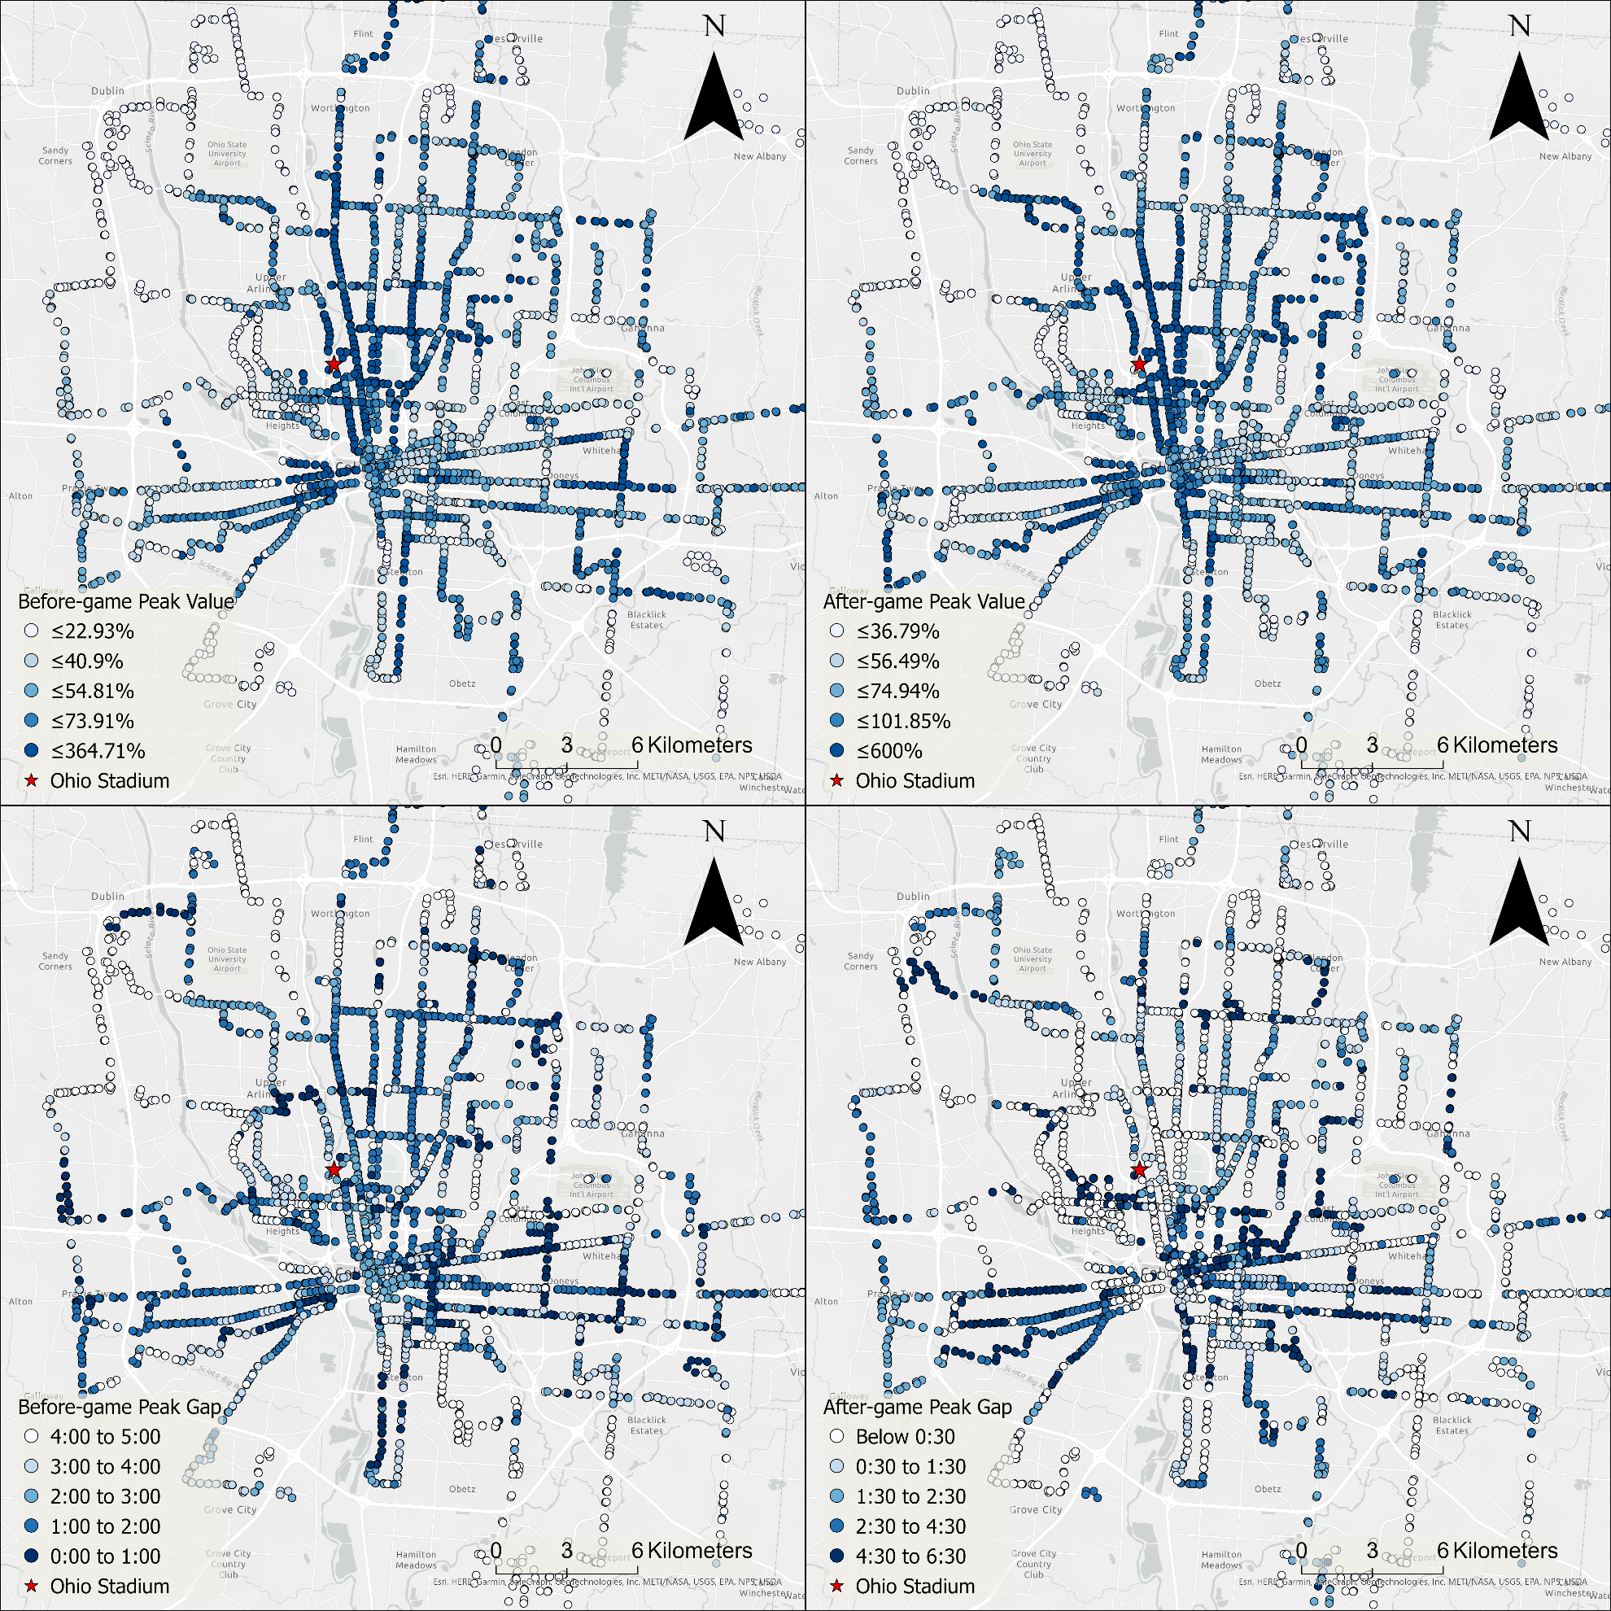
Football: Spatial Patterns
The highest value of unreliability before (up) and after (down) the game
Blue: more unreliable
White: more reliable
High cluster around Ohio Stadium
Strongly suggest the link between football and unexpectedly high unreliability

Slide 7
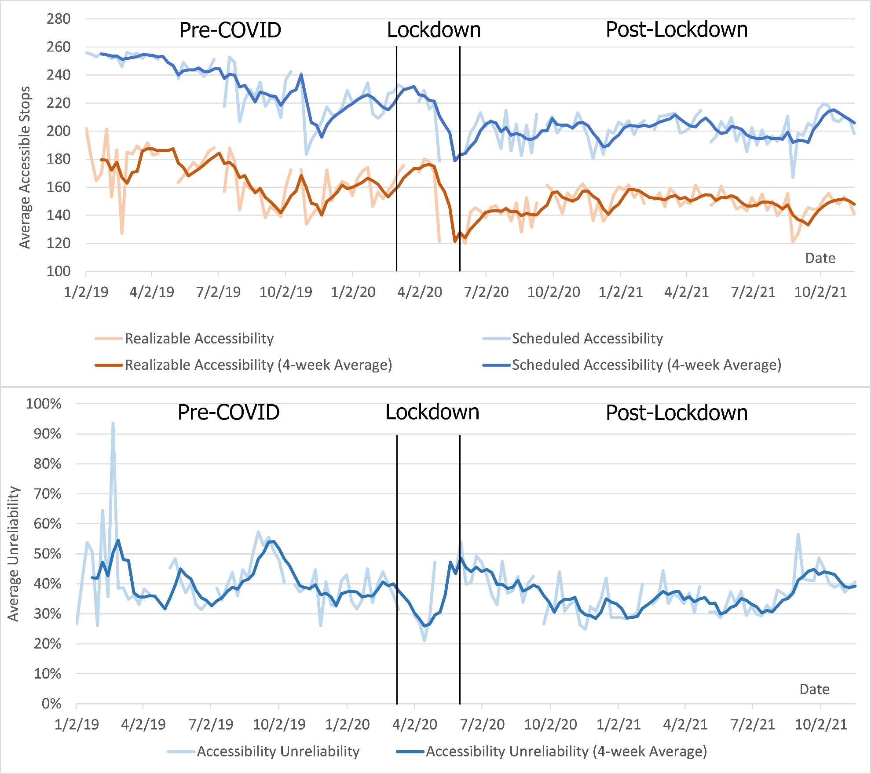
COVID-19: Temporal Pattern of Accessibility
Trend of accessibility from 2019 to 2021
Higher accessibility is better
Accessibility plunged during lockdown with service cut
Accessibility still stayed down after lockdown in 2021

Slide 8
COVID-19: Temporal Pattern of Unreliability
Trend of unreliability from 2019 to 2021
Higher accessibility is worse
Accessibility plunged during lockdown with service cut
Accessibility still stayed down after lockdown in 2021

Slide 9
Conclusion
We often overestimate the accessibility generated by transit
We should be more conservative when measuring accessibility and planning transit systems
New high spatial and temporal resolution transit data makes this possible

Slide 10
Next steps
Investigate the implications of accessibility unreliability on actual planning and demand
Measure the impacts of real-time information
We only analyze following the schedule as users’ planning strategy
Users can also use real-time information
Unreliability analysis in more cities and public transit systems

Slide 11



Thank you!
Contact
Luyu Liu: liu.6544@osu.edu
Adam Porr: porr.4@osu.edu
Harvey Miller: miller.81@osu.edu

